Slide 1
ARP Poisoning
S.Venkatesan
Indian Institute of Information Technology, Allahabad

Slide 2
Acknowledgement: The contents and figures are copied from various sources. Thanks to all authors and sources made those contents public and usable for educational purpose

Slide 3
Slides from
Lecture 20: Routing Security (Hijacking the Internet for fun and profit!), CSE390 – Advanced Computer Networks
Steve Kent, Security the Border Gateway Protocol using S-BGP
Slides of Prof. Sandeep Kumar Shukla
https://slideplayer.com/slide/2547379/

Slide 4
Introduction
A computer connected to an IP/Ethernet has two addresses
Address of network card (MAC address)
Globally unique and unchangeable address stored on the network card.
Ethernet header contains the MAC address of the source and the destination computer.
IP address
Each computer on a network must have a unique IP address to communicate.
Virtual and assigned by software.

Slide 5
Introduction
IP communicates by constructing packets.
Packet are delivered by Ethernet.
Adds an Ethernet header for delivery
Splits the packets into frames
Sends them down the cable to the switch.
The switch then decides which port to send the frame to. By comparing the destination address of the frame to an internal table which maps port numbers to MAC addresses.

Slide 6
Introduction
When an Ethernet frame is constructed from an IP packet, it has no idea what the MAC address of the destination machine is.
The only information available is the destination IP address.
There must be a way to the Ethernet protocol to find the MAC address of the destination machine, given a destination IP.
This is where ARP, Address Resolution Protocol, come in.

Slide 7
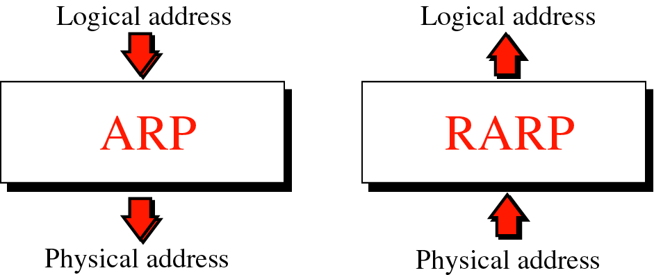
Address resolution and Reverse address resolution

Slide 8
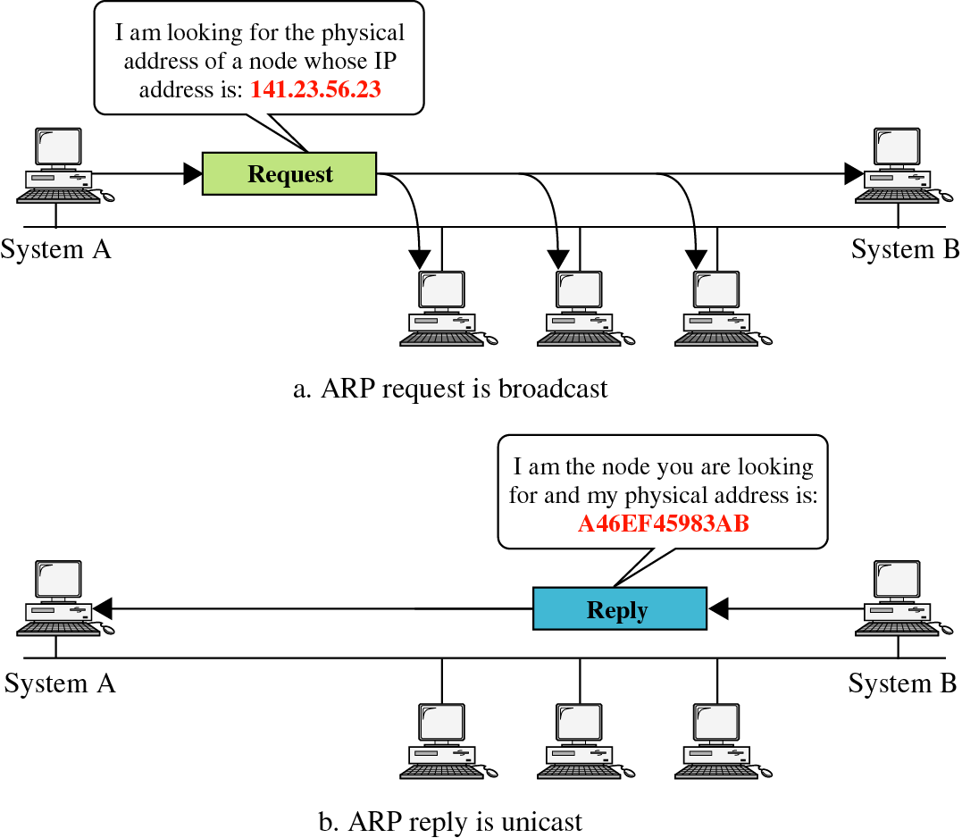

Slide 9
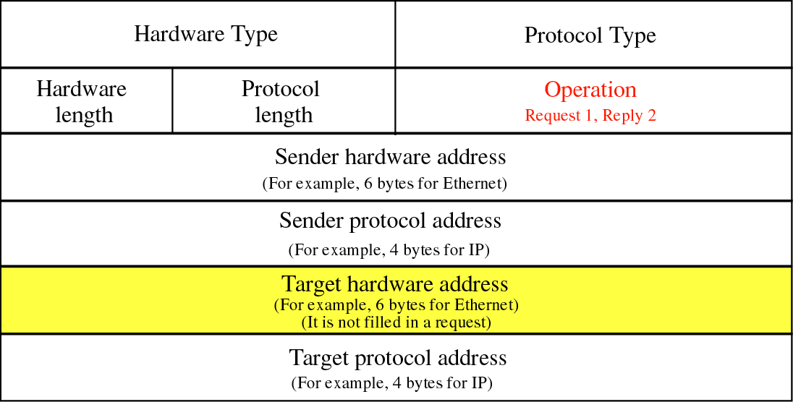

Slide 10
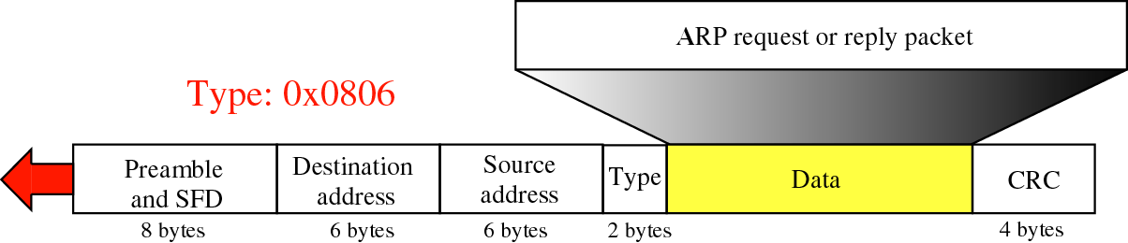
Encapsulation of ARP

Slide 11
ARP process
Get IP address of target.
Create a request ARP message
Fill sender physical address
Fill sender IP address
Fill target IP address
Target physical address is filled with 0
The message is passed to the data link layer where it is encapsulated in a frame.
Source address: physical address of the sender.
Destination address: broadcast address.

Slide 12
ARP process
Every host or router on the LAN receives the frame.
All stations pass it to ARP.
All machines except the one targeted drop the packet.
The target machine replies with an ARP message that contains its physical address.
A unicast message.
The sender receives the reply message and knows the physical address of the target machine.

Slide 13
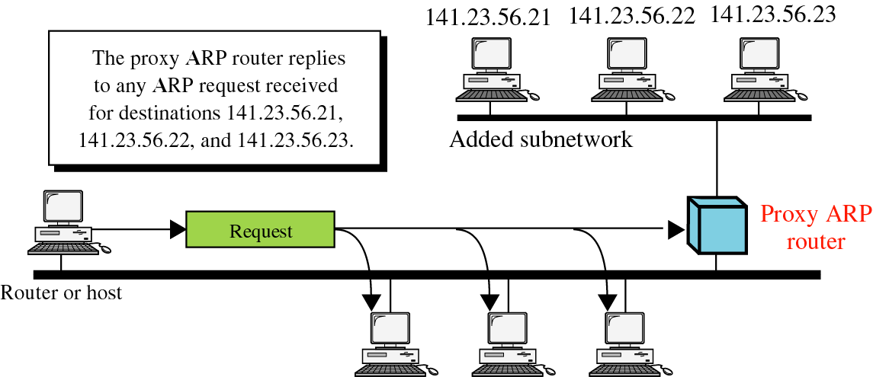

Slide 14
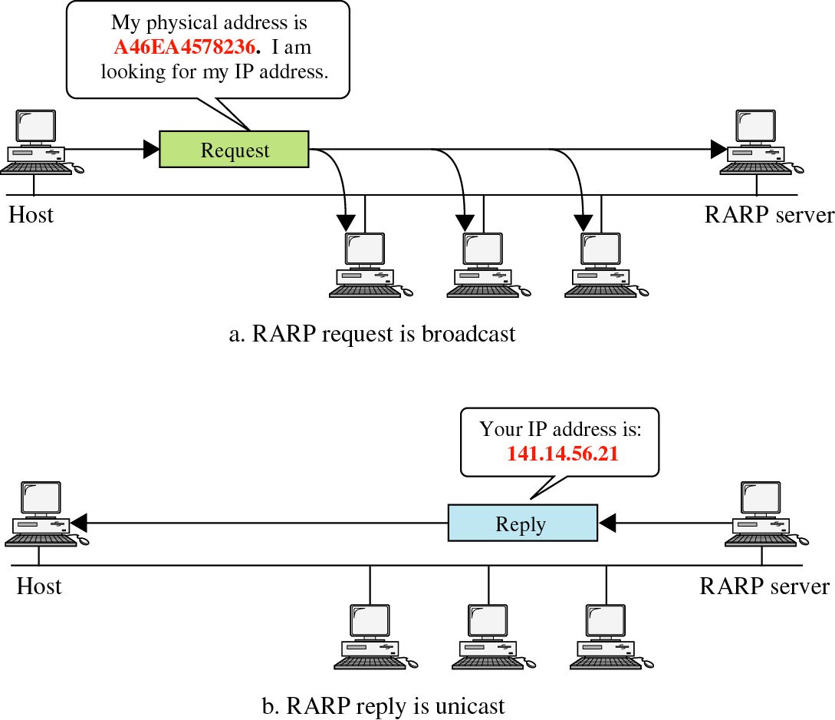

Slide 15
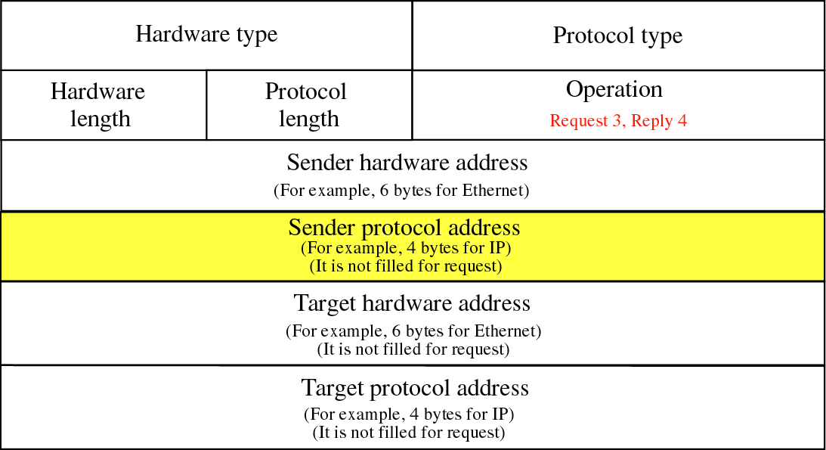
Figure 8-9

Slide 16
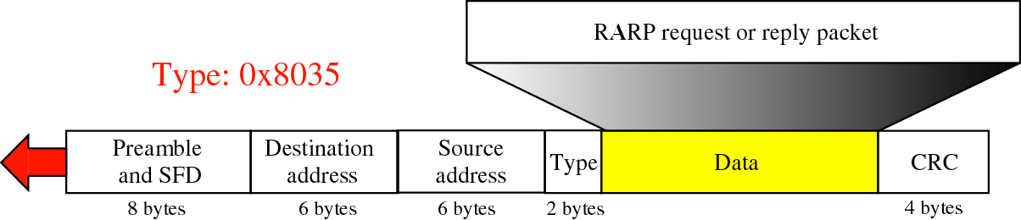

Slide 17
ARP Cache
To avoid having to send an ARP request packet each time, a host can cache the IP and the corresponding host addresses in its ARP table (ARP cache).
Each entry in the ARP table is usually “aged” so that the contents are erased if no activity occurs within a certain period.
When a computer receives an ARP reply, it will update its ARP cache.
ARP is a stateless protocol, most operating systems will update their cache if a reply is received, regardless of whether they have sent out an actual request.
https://superuser.com/questions/1345144/what-is-the-default-cache-refresh-rate-of-windows-8-and-ubuntu

Slide 18
ARP Spoofing
Construct spoofed ARP replies.
A target computer could be convinced to send frames destined for computer A to instead go to computer B.
Computer A will have no idea that this redirection took place.
This process of updating a target computer’s ARP cache is referred to as “ARP poisoning”.

Slide 19
Spoofed ARP reply
IP:10.0.0.2
MAC:cc:cc:cc:cc
Spoofed ARP reply
IP:10.0.0.2
MAC:cc:cc:cc:cc
switch
Spoofed ARP reply
IP:10.0.0.2
MAC:cc:cc:cc:cc
A
IP:10.0.0.1
MAC:aa:aa:aa:aa
B
IP:10.0.0.2
MAC:bb:bb:bb:bb
Hacker
IP:10.0.0.3
MAC:cc:cc:cc:cc
ARP cache
ARP cache
IP | MAC
10.0.0.2 | bb:bb:bb:bb
IP | MAC
10.0.0.1 | aa:aa:aa:aa

Slide 20
switch
A
IP:10.0.0.1
MAC:aa:aa:aa:aa
B
IP:10.0.0.2
MAC:bb:bb:bb:bb
Hacker
IP:10.0.0.3
MAC:cc:cc:cc:cc
ARP cache
ARP cache
IP | MAC
10.0.0.2 | cc:cc:cc:cc
IP | MAC
10.0.0.1 | aa:aa:aa:aa
A’s cache is poisoned

Slide 21
ARP Spoofing
Now all the packets that A intends to send to B will go to the hacker’s machine.
Cache entry would expire, so it needs to be updated by sending the ARP reply again.
How often?
depends on the particular system.
Usually every 40s should be sufficient.
In addition the hacker may not want his Ethernet driver talk too much

Slide 22
Man-in-the-Middle Attack
A hacker inserts his computer between the communications path of two target computers.
The hacker will forward frames between the two target computers so communications are not interrupted.
E.g., Hunt, Ettercap etc.
Can be obtained easily in many web archives.

Slide 23
Spoofed ARP reply
IP:10.0.0.2
MAC:cc:cc:cc:cc
Spoofed ARP reply
IP:10.0.0.2
MAC:cc:cc:cc:cc
switch
Spoofed ARP reply
IP:10.0.0.2
MAC:cc:cc:cc:cc
T1
IP:10.0.0.1
MAC:aa:aa:aa:aa
T2
IP:10.0.0.2
MAC:bb:bb:bb:bb
Hacker
IP:10.0.0.3
MAC:cc:cc:cc:cc
ARP cache
ARP cache
IP | MAC
10.0.0.2 | bb:bb:bb:bb
IP | MAC
10.0.0.1 | aa:aa:aa:aa

Slide 24
switch
T1
IP:10.0.0.1
MAC:aa:aa:aa:aa
T2
IP:10.0.0.2
MAC:bb:bb:bb:bb
Hacker
IP:10.0.0.3
MAC:cc:cc:cc:cc
ARP cache
ARP cache
IP | MAC
10.0.0.2 | cc:cc:cc:cc
IP | MAC
10.0.0.1 | aa:aa:aa:aa
T1’s cache is poisoned

Slide 25
Forged ARP replies
IP:10.0.0.1
MAC:cc:cc:cc:cc
switch
Forged ARP replies
IP:10.0.0.1
MAC:cc:cc:cc:cc
T1
IP:10.0.0.1
MAC:aa:aa:aa:aa
T2
IP:10.0.0.2
MAC:bb:bb:bb:bb
Hacker
IP:10.0.0.3
MAC:cc:cc:cc:cc
ARP cache
ARP cache
IP | MAC
10.0.0.2 | cc:cc:cc:cc
IP | MAC
10.0.0.1 | aa:aa:aa:aa

Slide 26
switch
T1
IP:10.0.0.1
MAC:aa:aa:aa:aa
T2
IP:10.0.0.2
MAC:bb:bb:bb:bb
Hacker
IP:10.0.0.3
MAC:cc:cc:cc:cc
ARP cache
ARP cache
IP | MAC
10.0.0.2 | cc:cc:cc:cc
IP | MAC
10.0.0.1 | cc:cc:cc:cc
T2’s cache is poisoned

Slide 27
Message intended to send to T2
switch
Hacker will
relay the
message
T1
IP:10.0.0.1
MAC:aa:aa:aa:aa
T2
IP:10.0.0.2
MAC:bb:bb:bb:bb
Hacker
IP:10.0.0.3
MAC:cc:cc:cc:cc
ARP cache
ARP cache
IP | MAC
10.0.0.2 | cc:cc:cc:cc
IP | MAC
10.0.0.1 | cc:cc:cc:cc

Slide 28
Hacker will relay the message
switch
Message
intended to
send to T1
T1
IP:10.0.0.1
MAC:aa:aa:aa:aa
T2
IP:10.0.0.2
MAC:bb:bb:bb:bb
Hacker
IP:10.0.0.3
MAC:cc:cc:cc:cc
ARP cache
ARP cache
IP | MAC
10.0.0.2 | cc:cc:cc:cc
IP | MAC
10.0.0.1 | cc:cc:cc:cc

Slide 29
Possible types of attacks
Sniffing
By using ARP spoofing, all the traffic can be directed to the hackers.
It is possible to perform sniffing on a switched network now.
DoS
Updating ARP caches with non-existent MAC addresses will cause frames to be dropped.
These could be sent out in a sweeping fashion to all clients on the network in order to cause a Denial of Service attack (DoS).
Hijacking
By using MiM attack, all the traffic of a TCP connection will go through the hacker.
Now it is much easier to hijack the session as compared to the other methods.

Slide 30
Possible types of attacks
Broadcasting
Frames can be broadcast to the entire network by setting the destination address to FF:FF:FF:FF:FF:FF (broadcast MAC).
By sweeping a network with spoofed ARP replies which set the MAC of the network gateway to the broadcast address, all external-bound data will be broadcast, thus enabling sniffing.
If a hacker listen for ARP requests and generate reply with broadcast address, large amounts of data could be broadcast on the networks.
Cloning
A MAC address is supposed to be unique.
It is possible to change the MAC address of a network card (burn into the ROM).
It is also possible to change the MAC on the OS level in some OS.
ifconfig
An attacker can DoS a target computer, then assign themselves the IP and MAC of the target computer, thus he can receive all frames intended for the target.

Slide 31
Defenses against ARP Spoofing
No Universal defense.
Use static ARP entries
Cannot be updated
Spoofed ARP replies are ignored.
ARP table needs a static entry for each machine on the network.
Large overhead
Deploying these tables
Keep the table up-to-date
Someone point out Windows still accepts spoofed ARP replies and updates the static entry with the forged MAC.
Sabotaging the purpose of static routes.
Port Security
Also known as port binding or MAC Binding.
A feature on some high-end switches.
Prevents changes to the MAC tables of a switch.
Unless manually performed by a network administrator.
Not suitable for large networks and networks using DHCP.

Slide 32
RARP (Reverse ARP)
Requests the IP of a known MAC.
Detect MAC cloning.
Cloning can be detected, if multiple replies are received for a single RARP.

Slide 33
Gratuitous ARP
Source and target IPs in the ARP request are the same.
In form of broadcast.
Some implementations recognize it as a special case, that of a system sending out updated information about itself to everybody, and cache that request.
One packet can screw up the entire network.

Slide 34
DAI
Dynamic ARP Inspection (DAI) is a security feature that protects ARP (Address Resolution Protocol) which is vulnerable to an attack like ARP poisoning.
DAI checks all ARP packets on untrusted interfaces, it will compare the information in the ARP packet with the DHCP snooping database and/or an ARP access-list. If the information in the ARP packet does not match, it will be dropped.
https://networklessons.com/switching/dai-dynamic-arp-inspection

Slide 35
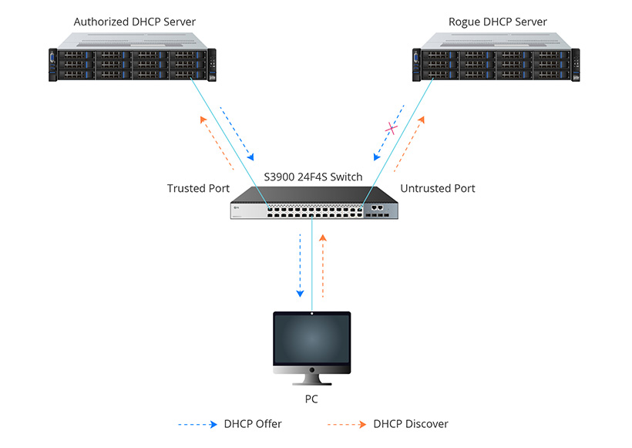
DHCP Snooping
Source - https://community.fs.com/blog/what-is-dhcp-snooping-and-how-it-works.html

Slide 36
MACSec
MACsec is a Layer 2 protocol that relies on GCM-AES-128 to offer integrity and confidentiality, and operates over ethernet.
It can secure all traffic within a LAN, including DHCP and ARP, as well as traffic from higher layer protocols.
It is an extension to 802.1X provides secure key exchange and mutual authentication for MACsec nodes.
IPsec (a Layer 3 security protocol) and TLS (a Layer 4 security protocol) offer different guarantees and can be a better fit, depending on the use case.
Ref: https://developers.redhat.com/blog/2016/10/14/macsec-a-different-solution-to-encrypt-network-traffic

Slide 37
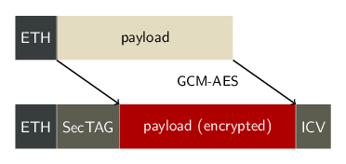
MACSec

Slide 38
References
https://www.ndss-symposium.org/wp-content/uploads/2017/09/Secure-Border-Gateway-Protocol-S-BGP.pdf
https://www.vpnfaqs.com/vpn-protocols-whats-the-best/
https://privacyaustralia.net/vpn-protocols/
https://zicodeng.medium.com/how-vpn-works-b7549dcc6ce4

